Slide 1
Final Exeter22 Presentation
Arsen Kaliyev, Jada Kim, Pranav Khurma, Kunal Arora, Nolan McNeill, Sarthak, Shivam Singh, Ved Nooka, Victoria Tan

Slide 2
Description of Strategy
We analyzed historical data from fifteen selected stocks using a two-stage strategy. First, we applied mean reversion and momentum trading strategies to assess market-driven behavior, evaluating performance with metrics such as Sharpe ratio, maximum drawdown, and volatility, supported by clear visualizations. In the second stage, we incorporated a fundamental, factor-based screening process using Return on Invested Capital (ROIC) and the Debt-to-Equity (D/E) ratio to identify stocks with strong capital efficiency and lower financial risk. This combined approach allowed us to assess both quantitative trading signals and fundamental financial health to optimize stock selection.
Notes:
Jada
We used a two-stage strategy to analyze the historical data of the given stocks. The mean reversion and momentum trading strategies were used to assess performance with metrics like Sharpe ratio, sortino ratio, max drawdown, and volatility. Then, using Return on Invested Capital and the Debt-to-Equity ratio for the factor-based strategy we identified the stocks with strong capital efficiency and lower financial risk in order to optimize stock selection.

Slide 3
Description of Work
Over the past five weeks, our team developed a multi-step backtesting engine that integrates momentum, mean reversion, and factor-based strategies to evaluate a set of 15 public equities. We began by implementing and testing momentum and mean reversion strategies, generating buy/sell signals. We then created a combined strategy that uses signal strength from both methods to form positions, which are held over a defined period. Next, we introduced multiple filters that evaluated each stock’s financial health, allowing us to exclude financially unstable stocks. Finally, we constructed a synthetic ETF to track OpenAI’s valuation by defining weights and testing different permutations of the ETF.
Notes:
Jada
So we developed a multi-step backtesting engine to integrate the strategies in order to evaluate the 15 public equities. We first generated buy and sell signals by implementing the momentum and mean reversion strategies. Then, we combined the strategies by evaluating the signal strength in order to form positions to be held over a defined period, all whilst evaluating the stock’s financial health using filters. To conclude our project, we created a synthetic ETF to track OpenAI’s evaluation by identifying weights and testing different permutations of the ETF.

Slide 4

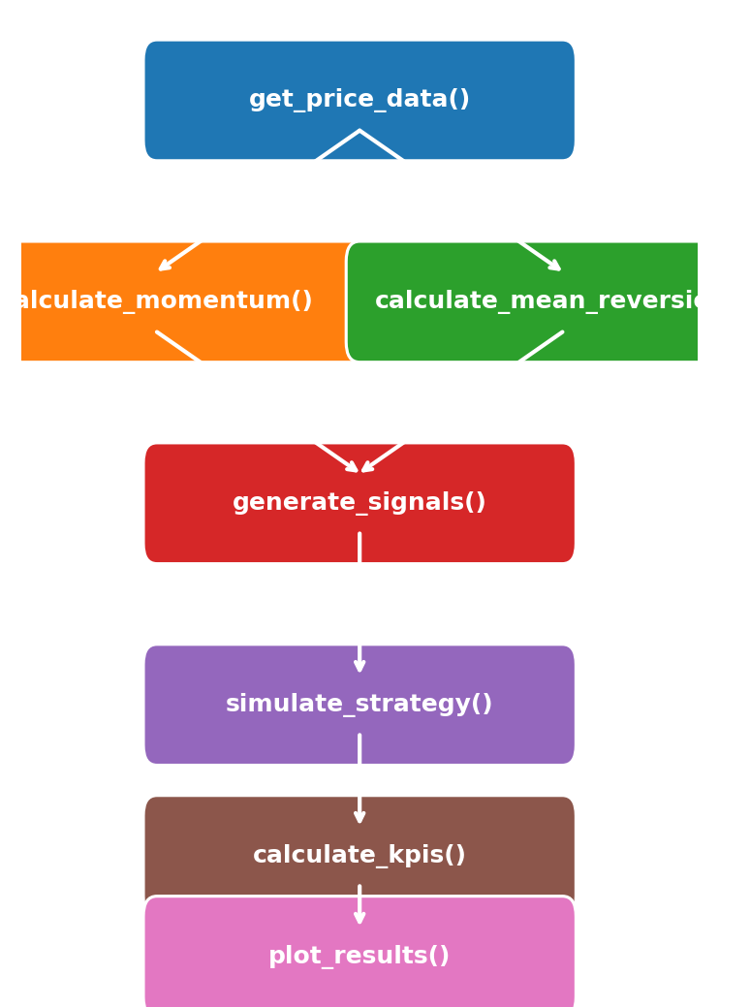
Backtesting Architecture & Workflow
Initial Data Pipeline: Cleans and normalizes raw price feeds for all tickers.
Parallel Signal Engines: Runs momentum and mean-reversion logic side-by-side.
End-to-End Automation: Single pipeline from signals through backtest to KPI visuals.
Time-Windowed Analysis: Each module uses defined lookback and holding periods for precise, period-specific backtesting.

Slide 5
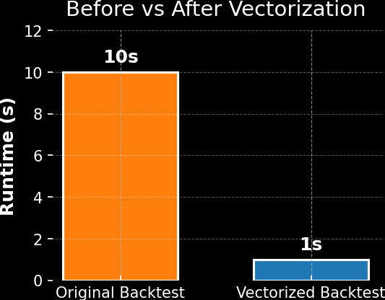
Key Coding Highlights & Impact
10× Speedup via Vectorization: Rewrote rolling‐window logic in calculate_momentum() from Python loops to Pandas ops (runtime ↓10 s → 1 s).
Efficient Optimization Loop: Pruned 48 million+ weight permutations to top 10 each iteration, cutting compute by > 90%.
Real-Time Signal Adaptation: Built dynamic thresholds that auto-adjust based on live volatility, keeping the strategy resilient through sudden market shocks.
Notes:
Nolan

Slide 6
Results - Analysis of KPIs - Across < 2.5 yrs
Return of strategy: ~93%
Return of holding even allocation of all stocks (baseline): 150%
Win rates: the win rate was 58.70%
Sharpe ratio: 1.31
Max drawdown: -6.6%
Average Trade Profit/Loss: +1.15%
Volatility: 3.59%
Notes:
Nolan

Slide 7
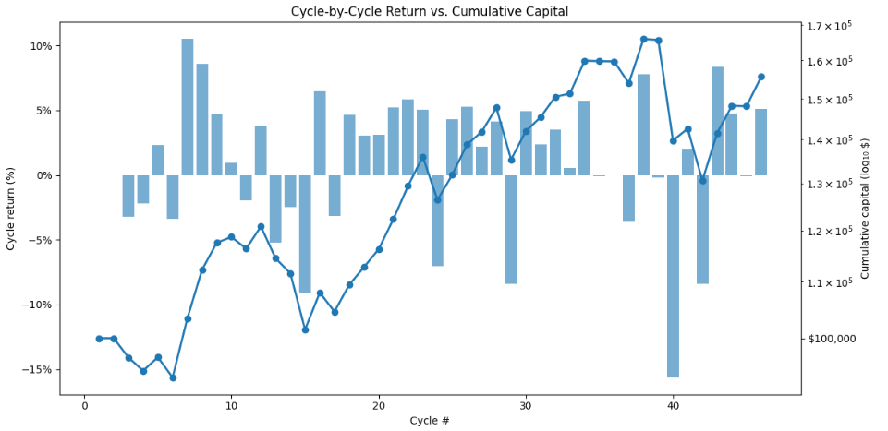
Results - Visualizations
Notes:
Nolan

Slide 8
Analysis
The strengths were that the momentum and mean-reversion strategies complimented each other nicely, as momentum successfully found well-performing assets with strong recent performance while mean reversion avoided volatility. This provided a good balance between growth and risk management.
The weaknesses were that the holding and look back period were chosen arbitrarily instead of being optimized through statistical analysis. Additionally, the mean reversion strategy consistently underperformed, and lastly, the momentum strategy was found to fall behind as it did not account for the most recent 21 days.
Notes:
Nolan

Slide 9
ETF Implementation and Backtesting
Aim: Track OpenAI by generating a synthetic return series
Proxies: NVDA, AMD, SMCI, ANET, MSFT, AMZN, SNOW, ADBE, ZM, GOOG, META
Created various permutations with [-0.50, -0.25, 0.00, +0.25, +0.50]
11 Stocks (rationale in report)
5 positions for each stock
Total: 48, 828, 125 Permutations! -> NEED to optimize!

Slide 10
Cont’ - Optimization
Step-optimization strategy
Randomly generate 10,000 permutations of positions
Evaluate & rank them based on the tracking error
Store the T10 in a file
Add the T10 permutations in the algorithm in the following run
Repeat

Slide 11
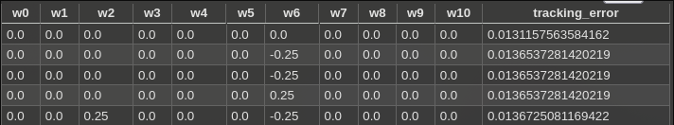
Results for ETF
Poor result, overfitting is observed and, null portfolios result in tracking error

Slide 12
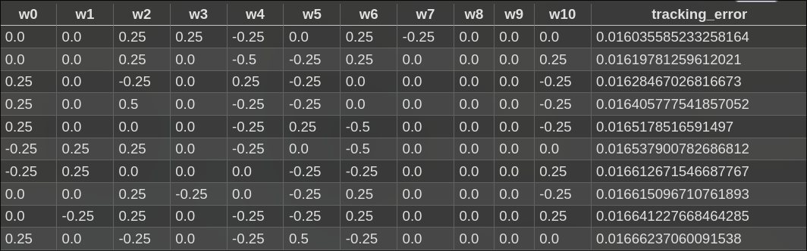
Results for ETF
Improvement: Added a diversification constraint

Slide 13
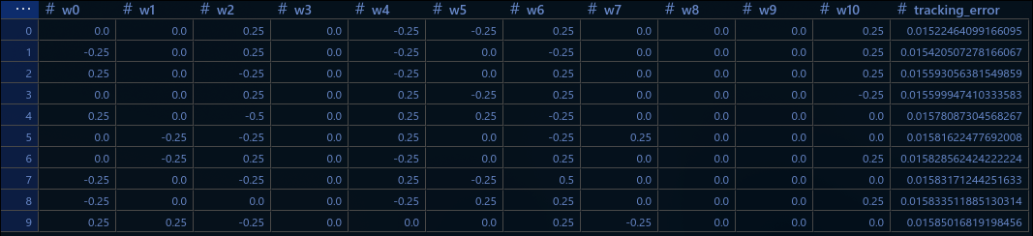
Results for ETF
Via our optimization algo, tracking error reduced down to 0.01522

Slide 14
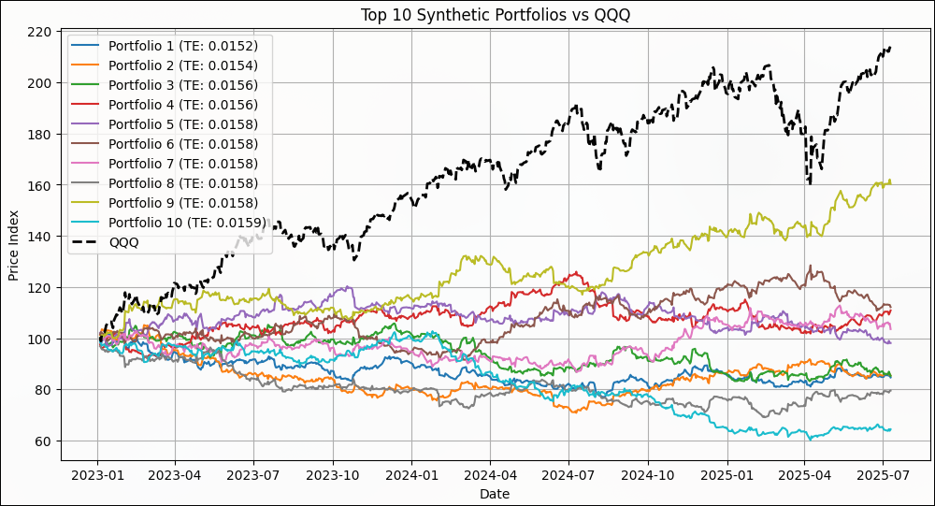

Slide 15
Contextualisation
Daily return volatility within 1.575% of QQQ
QQQ has NASDAQ T100 stocks (we have 11)
Very coarse positions, [-0.50, -0.25, 0.00, +0.25, +0.50]
Randomly sampled from 48 Million+ permutations
Good result.

Slide 16
Next Steps: Backtesting Engine
Optimize our strategy parameters (lookback, holding periods) using data-driven methods rather than arbitrary selection
Explore dynamic strategies (e.g., adjusting signals based on volatility or market regime shifts)
Improve logic of signal stacking between momentum and mean reversion to increase clarity
Add out-of-sample testing to validate the strategy over various market periods and environments
Notes:
Victoria

Slide 17
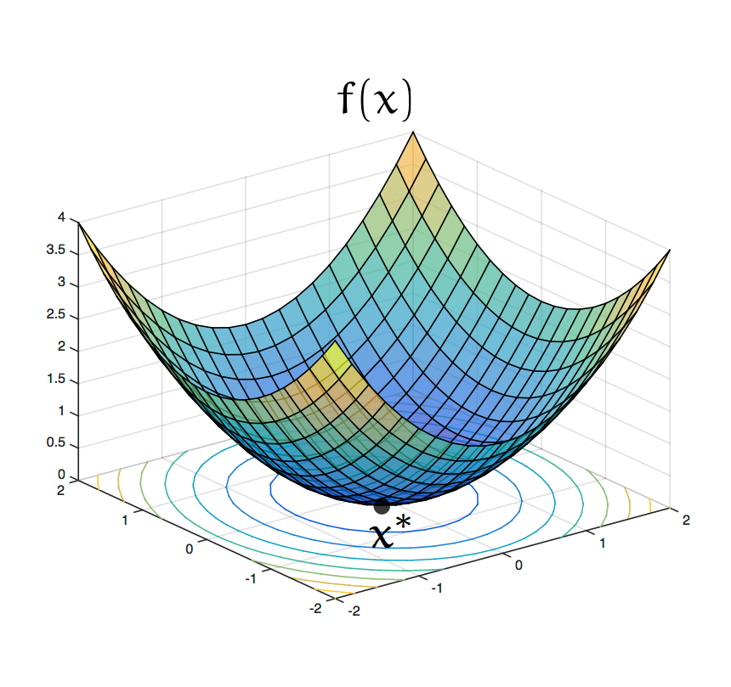
Next Steps: Synthetic ETF
Use smaller steps when adjusting the weights to fine tune positions (e.g., increments of 0.1 instead of 0.25)
Expand list of proxy tickers to improve how well we estimate OpenAI’s value exposure
Use more advanced optimization techniques instead of random sampling to construct a better-performing portfolio
Sequential Least SQuares (SLSQ)
Convex optimization
Notes:
Victoria
SLSQ - There are inbuilt methods for this in Scipy, making future implementation feasible.
Convex optimisation - From what we found online there have been people who have used convex optimisation to optimise their portfolios for benchmarks we can look into these in the future.

Slide 18
Thank you!

